Slide 1
AZ-220T01 Module 05: Insights and Business Integration

Slide 2
Lesson 01: Learning objectives

Slide 3
Module 5 – Learning objectives
Explain the options for business integration within an IoT solution and how to achieve them
Develop business integration support using Logic Apps and Event Grid
Configure IoT data and connection for Time Series Insights visualizations
Configure IoT data and connection for Power BI visualizations

Slide 4
Lesson 02: Business Integration for IoT Solutions

Slide 5
IoT Developer Role in Business Integration
Application Backend Processing
Roles Contributing to IoT Solution Implementation
Azure IoT Developer Responsibilities

Slide 6
Comparing cloud event and messaging options
Requirement | Simple queuing | Eventing and PubSub | Big data streaming | Enterprise messaging
Product | Queue storage | Event Grid | Event Hubs | Service Bus
Supported advantages | Communication within an app Individual message Queue semantics / polling buffer Simple and easy to use Pay as you go | Communication between apps / orgs Individual message Push semantics Filtering and routing Pay as you go Fan out | Many messages in a Stream (think in MBs) Ease of use and operation Low cost Fan in Strict ordering Works with other tools | Instantaneous consistency Strict ordering Java Messaging Service Non-repudiation and security Geo-replication and availability Rich features (such as deduplication and scheduling)
Weaknesses | Ordering of messaging Instantaneous consistency | Ordering of messaging Instantaneous consistency | Server-side cursor Only once | Cost Simplicity
Type | Serverless | Serverless | Big data | Enterprise
Notes:
Each of the messaging services that are used in the cloud have distinct use cases.
Storage Queues and Event Grid are both serverless services that are ideal for both simple and scaled-out workloads that don't have serious ordering or consistency requirements. If a workload does have strict requirements around consistency and order, the Service Bus service offers a more expensive and complex alternative.
The Event Hubs service is unique in that it's designed for streaming data that needs to remain consistent across multiple consumers.
This slide is a duplicate presentation of the next slide. Please choose the presentation you prefer; this slide is from a release of AZ-204, while the next slide was created new for this course.

Slide 7
Azure Event and Messaging Services
Service | Purpose | Type | When to use
Event Grid | Reactive programming | Event distribution (discrete) | React to status changes
Event Hubs | Big data pipeline | Event streaming (series) | Telemetry and distributed data streaming
Service Bus | High-value enterprise messaging | Message | Order processing and financial transactions
Azure Storage Queues | Simple, reliable, persistent messaging within and between services | Message | Very large message stores (over 80 GB), unreliable consumers
Notes:
This slide is a duplicate presentation of the previous slide. Please choose the presentation you prefer; the previous slide is from a release of AZ-204, while this slide was created new for this course.

Slide 8
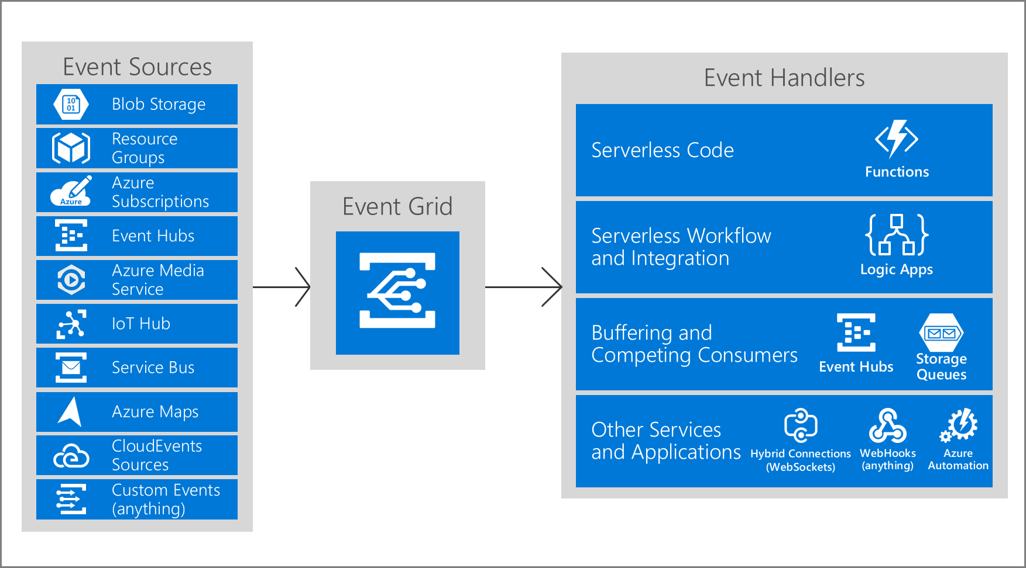
Business Integration with Event Grid
Notes:
If all students have the expected (but not officially required) developer knowledge coming in to the class, they will know about Azure Event Grid. If not, we’ll tackling it here.
Concepts
Events - What happened.
Event sources - Where the event took place.
Topics - The endpoint where publishers send events.
Event subscriptions - The endpoint or built-in mechanism to route events, sometimes to more than one handler. Subscriptions are also used by handlers to intelligently filter incoming events.
Event handlers - The app or service reacting to the event.
Key Features of Azure Event Grid:
Simplicity - Point and click to aim events from your Azure resource to any event handler or endpoint.
Advanced filtering - Filter on event type or event publish path to make sure event handlers only receive relevant events.
Fan-out - Subscribe several endpoints to the same event to send copies of the event to as many places as needed.
Reliability - 24-hour retry with exponential backoff to make sure events are delivered.
Pay-per-event - Pay only for the amount you use Event Grid.
High throughput - Build high-volume workloads on Event Grid with support for millions of events per second.
Built-in Events - Get up and running quickly with resource-defined built-in events.
Custom Events - Use Event Grid route, filter, and reliably deliver custom events in your app.

Slide 9
Message Routing or Event Grid Integration?
IoT Hub Message Routing and IoT Hub Event Grid integration have some conceptual overlaps… but they are targeting different use cases…
Decision Point | IoT Hub | Event Grid
Data type | Telemetry data, potentially with enhancement | Filtered unenhanced telemetry data and device lifecycle events
Next step endpoint | Limited number built-in with support for some connectors | Azure Functions, Logic Apps (next slide), Storage Accounts, Service Bus queues, webhooks
Ordering | Ordering maintained | Ordering not guaranteed
Notes:
What kind of data are you sending to the endpoints?
Use IoT Hub message routing when you have to send telemetry data to other services. Message routing also enables querying message application and system properties, message body, device twin tags, and device twin properties.
The IoT Hub integration with Event Grid works with events that occur in the IoT Hub service. These IoT Hub events include telemetry data, device created, deleted, connected, and disconnected. When subscribing to telemetry events, you can apply additional filters on the data to filter on message properties, message body and device twin in your IoT Hub, before publishing to Event Grid.
What endpoints need to receive this information?
IoT Hub message routing supports limited number of unique endpoints and endpoint types, but you can build connectors to reroute the data and events to additional endpoints.
The IoT Hub integration with Event Grid supports 500 endpoints per IoT Hub and a larger variety of endpoint types. It natively integrates with Azure Functions, Logic Apps, Storage and Service Bus queues, and also works with webhooks to extend sending data outside of the Azure service ecosystem and into third-party business applications.
Does it matter if your data arrives in order?
IoT Hub message routing maintains the order in which messages are sent, so that they arrive in the same way.
Event Grid does not guarantee that endpoints will receive events in the same order that they occurred. For those cases in which absolute order of messages is significant and/or in which a consumer needs a trustworthy unique identifier for messages, we recommend using message routing.

Slide 10
Introduction to Azure Logic Apps
How Logic Apps work – a trigger from a connector launches a business workflow to process data
Why to use Logic Apps – a visual designer with codeless implementation and dozens of connectors (including to IoT Hub) make it easy to do sophisticated workflows
Notes:
Point out that the visual designer is available in Visual Studio and in the Azure Portal, and that it maps to JSON under the hood, so Logic Apps can be in source control, etc.

Slide 11
Connectors for Azure Logic Apps
Connectors can be built-in, managed, or custom
Built-in connectors are core functionality such as calling a web site and receiving a reply
Managed connectors are Microsoft extensions to Logic Apps to talk to many different external systems
Custom connectors are your own code (these are not covered in this course, they are in the AZ-203 course)
All connectors have actions, which are directly mapped to code running in the connector
Connectors optionally support triggers, allowing them to be used to start a workflow
Notes:
“of course, the previous description of Logic Apps makes it clear that connectors are very important to Logic Apps…”

Slide 12
Lesson 03: Data Visualization with Time Series Insights

Slide 13
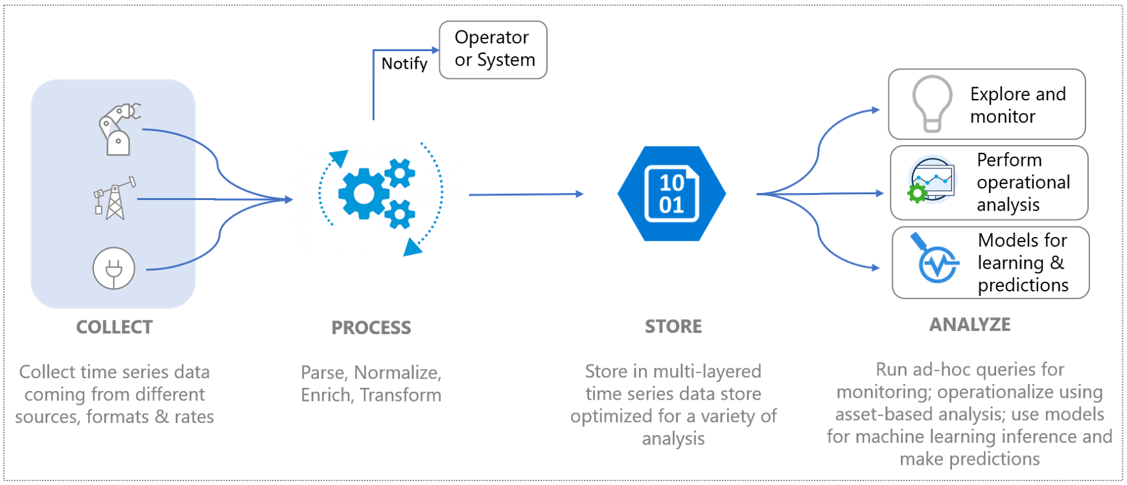
What is Azure Time Series Insights?
Notes:
“Logic Apps is a tool that can help you take actions based on IoT Hub events, whether telemetry events or non-telemetry events. If you have time series data – a specific category of telemetry events- that you would like to store, visualize, and query, you might find that a Logic App is not the best way to handle that. For those needs, we offer Azure Time Series Insights…”
Primary scenarios
Store time series data in a scalable way.
Explore data in near real time.
Perform root-cause analysis and detect anomalies.
Gain a global view of time series data that streams from disparate locations for multi-asset or site comparison.
Build a customer application on top of Time Series Insights.
Capabilities
Get started quickly
Near real-time insights
Build custom solutions
Scalability

Slide 14
Why use Azure Time Series Insights?
Time Series Insights gives a business the ability to examine historical data over long periods of time, including:
Discovery of data
Trending of data over time
Anomaly detection over time with basic machine learning
Notes:
Product group statement:
TSI is to simplify the visualisation [sic] of the data... you can connect TSI (PAYG) to IoT Hub and you get your data all going into blob storage (Gen 2). If you've got an issue, people can easily visualise [sic] what's going on in the data and then point the data scientists at that part of the data so they can start to build models to pick up the signals of the problem re-occurring. The data scientists can point ADX [Azure Data Explorer] at the same data that TSI uses. There's also a spark connector coming shortly.
(Teams post March 26, 2020, 9:08 AM US ET)

Slide 15
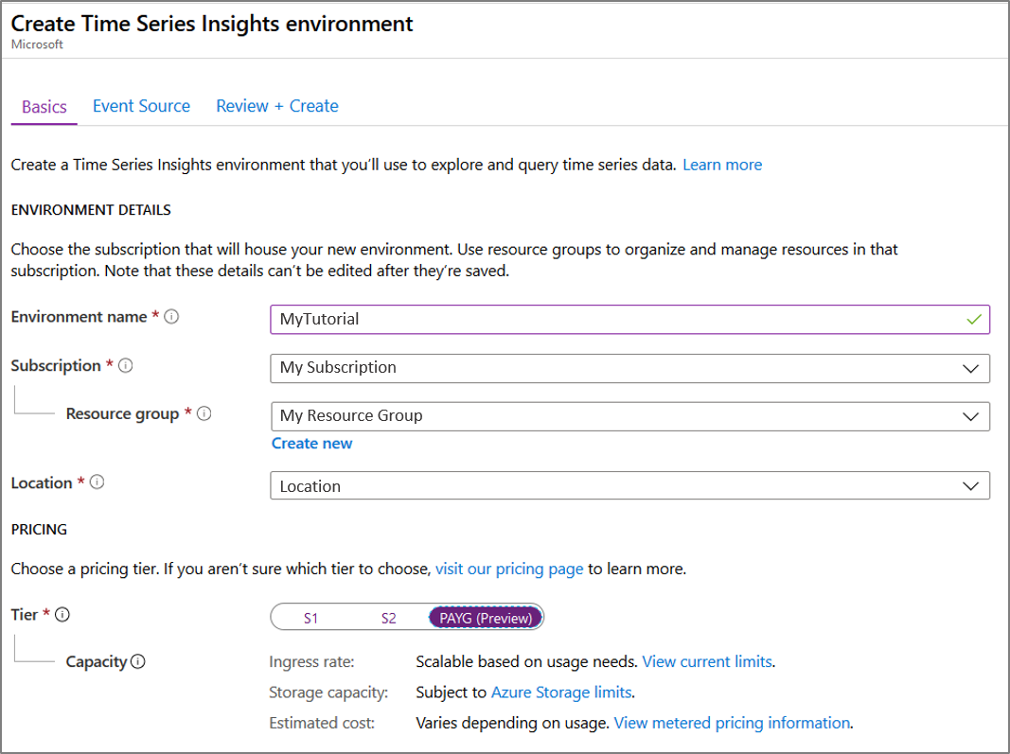
Configure the TSI Environment (1/3)
Notes:
These are some basic screenshots, but this is easy enough to demo and walkthrough, in which case of course skip or hide these slides.

Slide 16
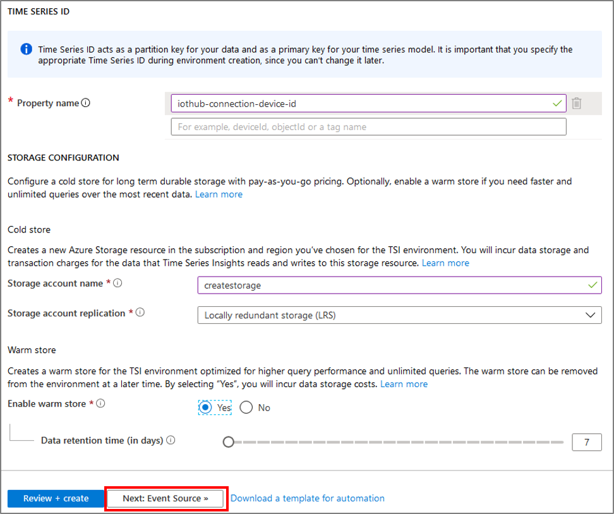
Configure the TSI Environment (2/3)

Slide 17
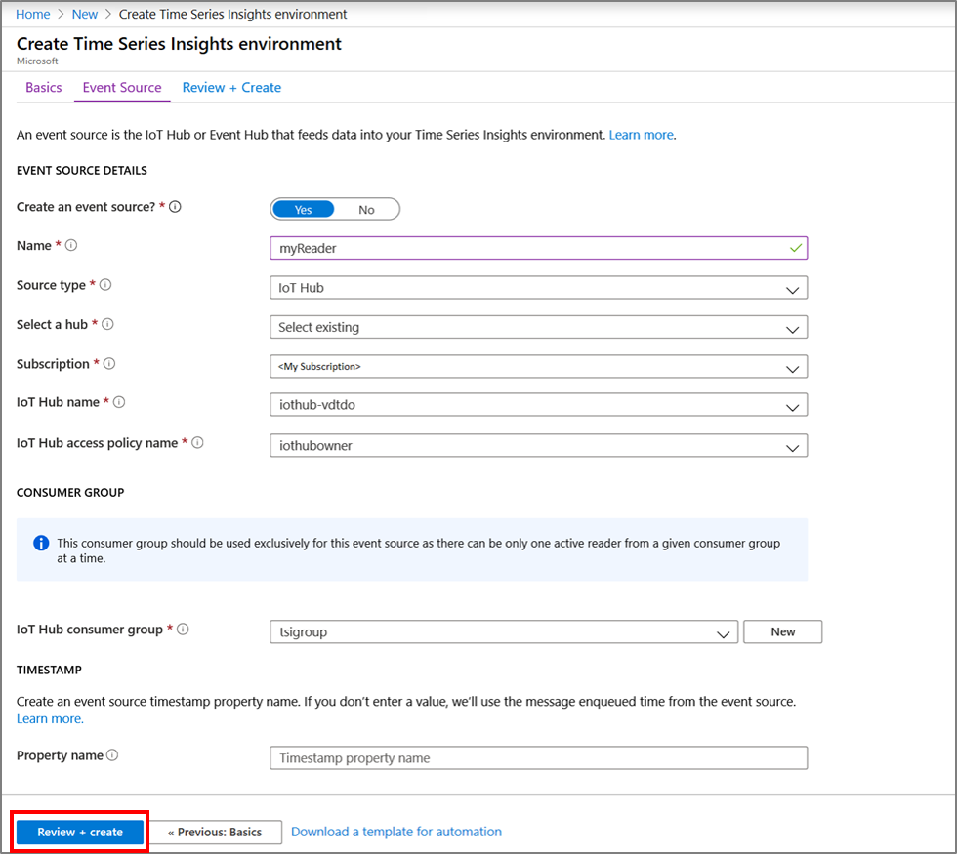
Configure the TSI Environment (3/3)

Slide 18
TSI Connection to IoT Hub
Create an IoT Hub Consumer Group for TSI
Create a TSI Event Source for IoT Hub

Slide 19
Lesson 04: Data Visualization with Power BI

Slide 20
What is Power BI Desktop?
Power BI is us used to:
Connect to data
Transform and clean data
Create visuals
Create reports
Share reports
Notes:
“Azure Time Series Insights gives us a robust, near-live visualization tool for time series data. The rest of the organization, however, has other data it is visualizing and sharing as well. How can you bring together the time series-focused TSI data with other data in the organization for visualization?”
We lightly introduce Power BI here and have it in the lab, but ultimately the job task analysis determined that visualization tasks are owned by a data analyst, not a developer.

Slide 21
Connect to Azure IoT Data Sources
Azure SQL Database
Azure SQL Data Warehouse
Azure Analysis Services database
Azure Blob Storage
Azure Table Storage
Azure Cosmos DB
Azure Data Lake Storage Gen2 (Beta)
Azure Data Lake Storage Gen1
Azure HDInsight (HDFS)
Azure HDInsight Spark
HDInsight Interactive Query
Azure Data Explorer (Kusto)
Notes:
There’s not an animation on this slide because the point is just to show that there are so many different way to pring in data to Power BI from Azure, including multiple data sources that we have used as targets for IoT data.

Slide 22
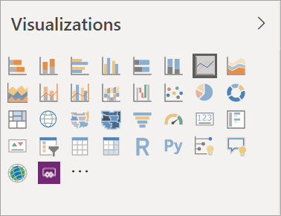
Data Visualization in Power BI

Slide 23
Lesson 05: Module Labs

Slide 24
Module 5 Labs
Lab 8: Visualize a Data Stream in Power BI
Lab 9: Integrate IoT Hub with Event Grid
Lab 10: Explore and analyze time stamped data with Time Series Insights

Slide 25
Lesson 06: Module 5 review questions

Slide 26
Module Review: Question 5.1
You are developing an IoT solution for your company. You have a large number of devices connected to IoT Hub. Each device is sending telemetry on a regular basis. You also have archived data available on both hot and cold paths. You need to analyze your data to develop insights, and then use those insights to trigger business integration tasks. You find documentation that recommends using Azure Event Grid.
What are some reasons to use Event Grid in your solution? (choose all correct answers)
Advanced filtering
High throughput
Unlimited free access.
Built-in and Custom Events
Notes:
Correct Answer: A, B, D
Explanation: In the student workbook/skillpipe content, topic Business Integration with Event Grid includes the following:
Capabilities
Here are some of the key features of Azure Event Grid:
Simplicity - Point and click to aim events from your Azure resource to any event handler or endpoint.
Advanced filtering - Filter on event type or event publish path to make sure event handlers only receive relevant events.
Fan-out - Subscribe several endpoints to the same event to send copies of the event to as many places as needed.
Reliability - 24-hour retry with exponential backoff to make sure events are delivered.
Pay-per-event - Pay only for the amount you use Event Grid.
High throughput - Build high-volume workloads on Event Grid with support for millions of events per second.
Built-in Events - Get up and running quickly with resource-defined built-in events.
Custom Events - Use Event Grid route, filter, and reliably deliver custom events in your app.

Slide 27
Module Review: Question 5.2
You are developing an IoT solution for your company. You have a large number of devices connected to IoT Hub. Each device is sending telemetry on a regular basis. You also have archived data available on both hot and cold paths. You need to analyze your data to develop insights, and then use those insights to trigger business integration tasks.
Which of the following describes how a Logic App works? (choose one best answer)
A Logic App is started by a trigger, which fires when a specific event happens or when certain criteria is met.
A Logic App is started by an event, which is generated programmatically by an app or service.
A Logic App is started by a command, which is issued by a user such as an IoT operator.
A Logic App is started by an event, which fires when an app or user issues a command.
Notes:
Correct Answer: A
Explanation: In the student workbook/skillpipe content, topic Introduction to Azure Logic Apps includes the following:
How Logic Apps work
Every logic app workflow starts with a trigger, which fires when a specific event happens, or when new available data meets specific criteria. Many triggers provided by the connectors in Logic Apps include basic scheduling capabilities so that you can set up how regularly your workloads run. For more complex scheduling or advanced recurrences, you can use a Recurrence trigger as the first step in any workflow. Learn more about schedule-based workflows.
Each time that the trigger fires, the Logic Apps engine creates a logic app instance that runs the actions in the workflow. These actions can also include data conversions and flow controls, such as conditional statements, switch statements, loops, and branching. For example, this logic app starts with a Dynamics 365 trigger with the built-in criteria "When a record is updated". If the trigger detects an event that matches this criteria, the trigger fires and runs the workflow's actions. Here, these actions include XML transformation, data updates, decision branching, and email notifications.
You can build your logic apps visually with the Logic Apps Designer, which is available in the Azure portal through your browser and in Visual Studio. For more custom logic apps, you can create or edit logic app definitions in JavaScript Object Notation (JSON) by working in the "code view" editor. You can also use Azure PowerShell commands and Azure Resource Manager templates for select tasks. Logic apps deploy and run in the cloud on Azure.

Slide 28
Module Review: Question 5.3
You are developing an IoT solution for your company. You have a large number of devices connected to IoT Hub. Each device is sending telemetry on a regular basis. You also have archived data available on both hot and cold paths. You need to analyze your data to develop insights, and then use those insights to trigger business integration tasks. You investigate using Azure Time Series Insights as part of your solution.
Which of the following accurately describe Time Series Insights? (choose all correct answers)
Time Series Insights is fully integrated with cloud gateways like Azure IoT Hub and Azure Event Hubs.
Time Series Insights manages the storage of your data.
Time Series Insights provides out-of-the-box visualization.
Time Series Insights provides an integrated query service.
Notes:
Correct Answer: A, B, C, D
Explanation: In the student workbook/skillpipe content, topic What is Time Series Insights includes the following:
Time Series Insights has four key jobs:
- It's fully integrated with cloud gateways like Azure IoT Hub and Azure Event Hubs. It easily connects to these event sources and parses JSON from messages and structures that have data in clean rows and columns. It joins metadata with telemetry, and then indexes your data in a columnar store.
- Time Series Insights manages the storage of your data. To make sure that data is always easily accessible, it stores your data in memory and SSDs for up to 400 days. You can interactively query billions of events in seconds–on demand.
- Time Series Insights provides out-of-the-box visualization through the Time Series Insights explorer.
- Time Series Insights provides a query service, both in the Time Series Insights explorer and by using APIs that are easy to integrate to embed your time series data into custom applications.

Slide 29
Module Review: Question 5.4
You are developing an IoT solution for your company. You have a large number of devices connected to IoT Hub. Each device is sending telemetry on a regular basis. You also have archived data available on both hot and cold paths. You need to analyze your data to develop insights, and then use those insights to trigger business integration tasks. You decide to use Time Series Insights as part of your solution.
Which of the following are required to connect TSI to IoT Hub? (choose all correct answers)
Use IoT Hub to create a custom endpoint that will be used exclusively by TSI.
Use IoT Hub to create a dedicated consumer group that will be used exclusively by TSI.
Use Time Series Insights to create an event source that uses your IoT Hub consumer group.
Use Time Series Insights to create an event source that uses your IoT Hub endpoint.
Notes:
Correct Answer: B, C
Explanation: In the student workbook/skillpipe content, topic TSI Connection to IoT Hub includes the following:
Once you have IoT Hub and TSI instances up and running, you are ready to create a dedicated consumer group in the IoT hub for the Time Series Insights environment to consume from. Each Time Series Insights event source must have its own dedicated consumer group that isn't shared with any other consumer. If multiple readers consume events from the same consumer group, all readers are likely to see failures.
Create an IoT Hub Consumer Group for TSI
Applications use consumer groups to pull data from Azure IoT Hub. To reliably read data from your IoT hub, provide a dedicated consumer group that's used only by this Time Series Insights environment.
Under Consumer groups, enter a unique name for the consumer group. You will use this same name in your Time Series Insights environment when you create your event source.
Create a TSI Event Source for IoT Hub
Switching over to the TSI side, you need to create the Event Source that you will be using to access IoT Hub data.
To begin the process of creating your new event source, you will first provide an Event source name (a name that's unique to this Time Series Insights environment) and specify that your Source will be an IoT Hub. Once you have these properties set, you will have a choice between using an IoT Hub from an available subscription and providing IoT Hub settings manually. The property settings requirements will be different based on your choice.

